Slide 2
Ministry of Higher Education and Scientific Research Board of Technical Education Technical College / Musayyib
Educational material for the bag manufacturing operations For students of Technical College - Musayyib Department of Agricultural Machinery and Equipment / Phase third
Preparation and design Ali Hassan Hamza Assistant Lecturer in Technical College / Musayyib 2011-2010

Slide 3
First module
Cutting process

Slide 4
-1- (over view) :
A-Target group:-
students of Technical College - Musayyib / Department of Agricultural Machinery and Equipment / third phase. B- Rationale:-
This unit is designed to introduce students to: - turning process and its determinants. C- Central ideas / To recognize the student to:
1 - the principle of the process of turning. 2 - the determinants of the process of turning. 3 - Turning machines............ -

Slide 5
D- Objectives:-
student will be after the completion of the study the module able to: - A - recognize the gears process
C - chip resulting from the cutting process and its determinants

Slide 6
-: 2- pre-testing
Circle the letter preceding the correct answer for each of the following:
1 - The process (Cutting ) from operations: - A - driver. B - formation. 2 - after a process (cutting ) gets in the product: - A - decrease in size. B - Increase the volume. C - conservative on the size. 3 - the most important side effect of the process (cutting ) are: - A - improve the mechanical properties of busy. B - Increasing the hardness of the surface is busy.

Slide 7
Notes: Check the safety of your answers back to the page (the answers to the test keys) at the end of the first module - If you got (8) degrees or more, you do not need to continue to study this module. - If you got less than (8) degrees, you must continue to study this module

Slide 8
3- Display module

Slide 9
Cutting fluid is a type of coolant and lubricant designed specifically for metalworking and machining processes. There are various kinds of cutting fluids, which include oils, oil-water emulsions, pastes, gels, aerosols (mists), and air or other gases. They may be made from petroleum distillates, animal fats, plant oils, water and air, or other raw ingredients. Depending on context and on which type of cutting fluid is being considered, it may be referred to as cutting fluid, cutting oil, cutting compound, coolant, or lubricant.
Most metalworking and machining processes can benefit from the use of cutting fluid, depending on work piece material.
A common exception to this is machining cast iron or brass, which are machined dry.
The properties that are sought after in a good cutting fluid are the ability to:

Slide 10
1- keep the work piece at a stable temperature (critical when working to close tolerances).
2- Very warm is OK, but extremely hot or alternating hot-and- cold are avoided.
3- maximize the life of the cutting tip by lubricating the working edge and reducing tip welding.
4- Ensure safety for the people handling it (toxicity, bacteria, fungi) and for the environment upon disposal.
prevent rust on machine parts and cutters.

Slide 11
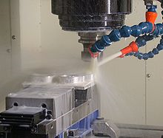

Slide 12
-: Cooling
Metal cutting operations generate heat due to tool friction and energy lost deforming the material. The surrounding air is a poor coolant for the cutting tool because it conducts heat poorly and has low thermal mass. Ambient-air cooling is adequate for light cuts and low duty cycles typical of maintenance, repair and operations (MRO) or hobbyist work. However, production work requires heavy cutting over long time periods and typically produces more heat than air cooling can remove. Rather than pausing production while the tool cools, using liquid coolant removes significantly more heat more rapidly, and can also speed cutting and reduce friction and tool wear.

Slide 13
- : Lubrication
Besides cooling, cutting fluids also aid the cutting process by lubricating the interface between the tool's cutting edge and the chip. By preventing friction at this interface, some of the heat generation is prevented. This lubrication also helps prevent the chip from being welded onto the tool, which interferes with subsequent cutting.
Extreme pressure additives are often added to cutting fluids to further reduce tool wear.

Slide 14
:-Cutting fluids
Water 1-
It has a high specific heat but is poor in lubrication and also encourages rusting. It is used as a cooling agent during tool grinding.

Slide 15
2-Soluble Oils
Oil will not dissolve in water but can be made to form an intimate mixture or emulsion by adding emulsifying agents. The oil is then suspended in the water in the form of tiny droplets. These fluids have average lubricating abilities and good cooling properties. Soluble oils are suitable for light cutting operations on general purpose machines where high rates of metal removal are often not of prime importance. There are many forms of soluble oil in the market and the suppliers instruction should be followed regarding the proportions of the `mix'.

Slide 16
Mineral Oils 3-
They are used for heavier cutting operations because of their good lubricating properties and are commonly found in production machines where high rates of metal removal are employed. Mineral oils are very suitable for steels but should not be used on copper or its alloys since it has a corrosive effect
. Vegetable Oils 4-
They are good lubricants but are of little used since they are liable to decompose and smell badly.

Slide 17
Cutting Tool Materials

Slide 18
High Carbon Steel 1-
Contains) 1-1.4%) carbon with some addition of chromium and tungsten to improve wear resistance. The steel begins to lose its hardness at about (250)° and is not favoured for modern machining operations where high speeds and heavy cuts are usually employed.
2-Hot Hardness
This means the ability to retain its hardness at high temperatures. All cutting operations generate heat, which will affect the tool¡¦s hardness and eventually its ability to cut

Slide 19
-: 3-Strength and Resistance to Shock
At the start of a cut the first bite of the tool into the work results in considerable shock loading on the tool. It must obviously be strong enough to withstand.
-: Low Coefficient of Friction 4-
The tool rubbing against the workpiece and the chip rubbing on the top face of the tool produce heat which must be kept to a minimum.

Slide 20
Chip Formation & Chip Breaker

Slide 21
Chip Formation & Chip Breaker :-
The type of chip produced depends on the:-
1-material being machined .
2-cutting conditions at the time.
These conditions include the type of tool used tool, rate of cutting condition of the machine and the use or
absence of a cutting fluid.
Continuous Chip
This leaves the tool as a long ribbon and is common when cutting most ductile materials such as mild steel, copper and Aluminum. It is associated with good tool angles, correct speeds and feeds, and the use of cutting fluid.

Slide 22
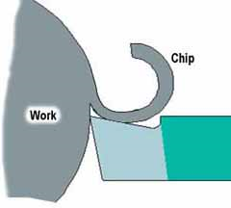

Slide 23
Discontinuous Chip
The chip leaves the tool as small segments of metal resulted from cutting brittle metals such as cast iron and cast brass with tools having small rake angles. There is nothing wrong with this type of chip in these circumstances

Slide 24
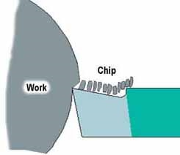

Slide 25
-:Continuous Chip with Build-up Edge
This is a chip to be avoided and is caused by small particles from the work piece becoming welded to the tool face under high pressure and heat. The phenomenon results in a poor finish and damage to the tool. It can be minimized or prevented by using light cuts at higher speeds with an appropriate cutting lubricant

Slide 26
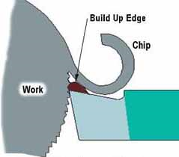

Slide 27
Chip Breaker
A chip breaker is used to break the continuous chip into sections so that the chips cannot tangle around the cutting tool. The simplest form of chip breaker is made by grinding a groove on the tool face a few millimeters behind the cutting edge.

Slide 28
Post-test :-
Circle the letter preceding the correct answer for each of the following:
1 - by-products of the process () is: - A - Reich. B - oxidation surfaces. C - Changes the structure of the metal. 2 - dimensional measurements to Products process () are: - A - final. Z - is infinite. 3 - called the operating tools used in the process (): - A - cutting tools. B - the formation of molds.

Slide 29
Ministry of Higher Education and Scientific Research Board of Technical Education Technical College / Musayyib
Educational material for the bag manufacturing operations For students of Technical College - Musayyib Department of Agricultural Machinery and Equipment / Phase third
Preparation and design Ali Hassan Hamza Assistant Lecturer in Technical College / Musayyib 2011-2010

Slide 30
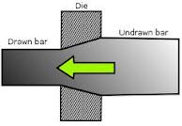
First module
Drawing process

Slide 31
1- (over view) :
A-Target group:-
students of Technical College - Musayyib / Department of Agricultural Machinery and Equipment / third phase. B- Rationale:-
This unit is designed to introduce students to: - turning process and its determinants. C- Central ideas / To recognize the student to:
1 - the principle of the process of turning. 2 - the determinants of the process of turning. 3 - Turning machines............

Slide 32
D- Objectives:-
student will be after the completion of the study the module able to: - A - recognize the gears process
C - chip resulting from the cutting process and its determinants

Slide 33
2- pre-testing
Circle the letter preceding the correct answer for each of the following
1 - The process (Cutting ) from operations: - A - driver. B - formation. 2 - after a process (cutting ) gets in the product: - A - decrease in size. B - Increase the volume. C - conservative on the size. 3 - the most important side effect of the process (cutting ) are: - A - improve the mechanical properties of busy. B - Increasing the hardness of the surface is busy

Slide 34
Note: 1. Each question one degree. 2. Please check that your answer review page (key answers to the tests) at the end of the module, in case you get the degree thus only 9 more needy to study this unit and go to the next unit of study. In case you have a degree less than 9 will need to study this unit.

Slide 35
3- Display module

Slide 36
Drawing dies
Drawing dies are typically made of tool steel, tungsten carbide, or diamond, with tungsten carbide and manufactured diamond being the most common. For drawing very fine wire a single crystal diamond die is used. For hot drawing, cast-steel dies are used.^{[citation needed]} For steel wire drawing, a tungsten carbide die is used. The dies are placed in a steel casing, which backs the die and allow for easy die changes. Die angles usually range from 6–15°, and each die has at least 2 different angles: the entering angle and approach angle. Wire dies usually are used with power as to pull the wire through them. There are coils of wire on either end of the die which pull and roll up the wire with a reduced diameter.

Slide 37
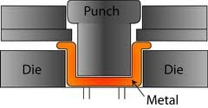

Slide 38
Wire drawing is a metalworking process used to reduce the cross-section of a wire by pulling the wire through a single, or series of, drawing die(s). There are many applications for wire drawing, including electrical wiring, cables, tension-loaded structural components, springs, paper clips, spokes for wheels, and stringed musical instruments. Although similar in process, drawing is different from extrusion, because in drawing the wire is pulled, rather than pushed, through the die. Drawing is usually performed at room temperature, thus classified as a cold working process, but it may be performed at elevated temperatures for large wires to reduce forces. More recently drawing has been used with molten glass to produce high quality optical fibers.

Slide 39
Process
The wire drawing process is quite simple in concept. The wire is prepared by shrinking the beginning of it, by hammering, filing, rolling or swaging, so that it will fit through the die; the wire is then pulled through the die. As the wire is pulled through the die, its volume remains the same, so as the diameter decreases, the length increases. Usually the wire will require more than one draw, through successively smaller dies, to reach the desired size. The American wire gauge scale is based on this. This can be done on a small scale with a draw plate, or on a large commercial scale using automated machinery. The process of wire drawing improves material properties due to cold working.

Slide 40
The areal reduction of small wires are 15–25% and larger wires are 20–45%. Very fine wires are usually drawn in bundles. In a bundle, the wires are separated by a metal with similar properties, but with lower chemical resistance so that it can be removed after drawing. If the reduction in diameter is greater than 50%, the process may require annealing between the process of drawing the wire through the dies. Commercial wire drawing usually starts with a coil of hot rolled 9 mm (0.35 in) diameter wire. The surface is first treated to remove scales. It is then fed into either a single block or continuous wire drawing machine.

Slide 41
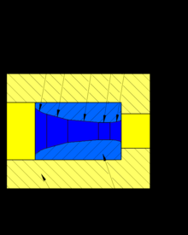
Diagram of a carbide wire drawing die

Slide 42
Single block wire drawing machines include means for holding the dies accurately in position and for drawing the wire steadily through the holes. The usual design consists of a cast-iron bench or table having a bracket standing up to hold the die, and a vertical drum which rotates and by coiling the wire around its surface pulls it through the die, the coil of wire being stored upon another drum or "swift" which lies behind the die and reels off the wire as fast as required. The wire drum or "block" is provided with means for rapidly coupling or uncoupling it to its vertical shaft, so that the motion of the wire may be stopped or started instantly. The block is also tapered, so that the coil of wire may be easily slipped off upwards when finished..

Slide 43
Before the wire can be attached to the block, a sufficient length of it must be pulled through the die; this is effected by a pair of gripping pincers on the end of a chain which is wound around a revolving drum, so drawing the wire until enough can be coiled two or three times on the block, where the end is secured by a small screw clamp or vice. When the wire is on the block, it is set in motion and the wire is drawn steadily through the die; it is very important that the block rotates evenly and that it runs true and pulls the wire at a constant velocity, otherwise "snatching" occurs which will weaken or even break the wire. The speeds at which wire is drawn vary greatly, according to the material and the amount of reduction

Slide 44
Continuous wire drawing machines differ from the single block machines in having a series of dies through which the wire passes in a continuous manner. The difficulty of feeding between each die is solved by introducing a block between each die. The speeds of the blocks are increased successively, so that the elongation is taken up and any slip compensated for. One of these machines may contain 3 to 12 dies. The operation of threading the wire through all the dies and around the blocks is termed "stringing-up". The arrangements for lubrication include a pump which floods the dies, and in many cases also the bottom portions of the blocks run in lubricant.
Often intermediate anneals are required to counter the effects of cold working, and to allow more further drawing. A final anneal may also be used on the finished product to maximize ductility and electrical conductivity.

Slide 45
An example of product produced in a continuous wire drawing machine is telephone wire. It is drawn 20 to 30 times from hot rolled rod stock.
While round cross-sections dominate most drawing processes, non-circular cross-sections are drawn. They are usually drawn when the cross-section is small and quantities are too low to justify rolling. In these processes, a block or Turk's-head .machine are used
Lubrication
Lubrication in the drawing process is essential for maintaining good surface finish and long die life. The following are different methods of lubrication
Wet drawing: the dies and wire or rod are completely immersed in lubricant
Dry drawing: the wire or rod passes through a container of lubricant which coats the surface of the wire or rod
Metal coating: the wire or rod is coated with a soft metal which acts as a solid lubricant
Ultrasonic vibration: the dies and mandrels are vibrated, which helps to reduce forces and allow larger reductions per pass
Various lubricants, such as oil, are employed. Another lubrication method is to immerse the wire in a copper (II) sulfate solution, such that a film of copper is deposited which forms a kind of lubricant.

Slide 46
Mechanical Properties
The strength-enhancing effect of wire drawing can be substantial. The highest gruel strengths available on any steel have been recorded on small-diameter cold-drawn austenitic stainless wire. Tensile strength can be as high as 400 ksi (3760 MPa).

Slide 47
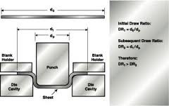
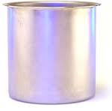
Deep Drawing

Slide 48
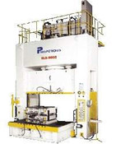
Metal drawing is a metal forming processing that stretches sheet metal stock, commonly referred to as a blank, around a plug. The edges of the metal blank are restrained by rings and the plug is drawn into a top die cavity to achieve the desired end shape. Metal drawing provides a low cost way to make thin-wall, relatively simple, 3D shapes in moderate to large quantity. Shapes must have draft to allow ejection from the tooling.
Some example of parts made by metal drawing include cups, pans, domes, etc. Metal drawing can form most ductile metals such as aluminum, copper, nickel, mild steel, stainless steel and magnesium. The tooling for metal drawing is made of steel. Cost reduction options include minimizing size, complexity and ratio of depth to width.

Slide 49
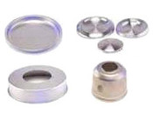
Sample parts made by metal drawing

Slide 50
Metal Drawing Machine

Slide 51
Drawing Tubes
Carrying around loose sheets of paper is never really a good idea, especially when they turn out to be important drawings or plans, so if you’re transporting your work around allot then it’s definitely a good idea to get a drawing tube.
Drawing tubes aren’t simply a plastic tube for putting work in; they have so many more uses you’re bound to get your money’s worth!
As the drawing tubes are extendable you can fit paper up to A0 in size into the tube and adjust for pretty much any paper size below, and with two diameters available you are sure to get a drawing tube that fits the bill.
You can also tape them up and use them as a sturdy postal tube, or as some of our customers have found, they provide light tight protection for larger photographic prints when transporting undeveloped paper

Slide 52
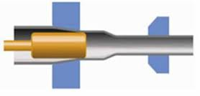
cold-drawing-tubes

Slide 53
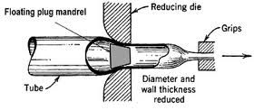
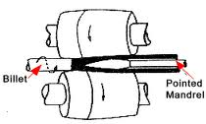

Slide 54
for Drawing Thin Tubes

Slide 55
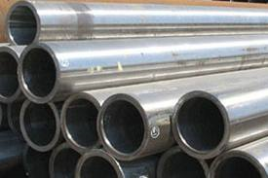
Clod drawing steel tubes

Slide 56
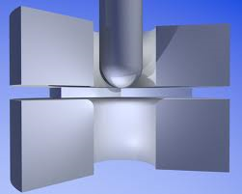
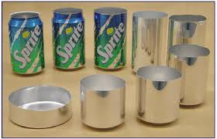
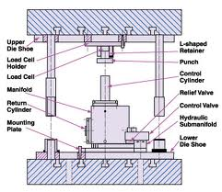

Slide 57
Post-test :-
Circle the letter preceding the correct answer for each of the following:
1 - by-products of the process () is: - A - Reich. B - oxidation surfaces. C - Changes the structure of the metal. 2 - dimensional measurements to Products process () are: - A - final. B - is infinite. 3 - called the operating tools used in the process (): - A - cutting tools. B - the formation of molds.

Slide 58
Educational material for the bag manufacturing operations For students of Technical College - Musayyib Department of Agricultural Machinery and Equipment / Phase third
Ministry of Higher Education and Scientific Research Board of Technical Education Technical College / Musayyib
Preparation and design Ali Hassan Hamza Assistant Lecturer in Technical College / Musayyib 2011-2010

Slide 59
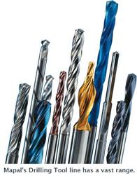
First module
Drilling process

Slide 60
1- (over view) :
A-Target group:-
students of Technical College - Musayyib / Department of Agricultural Machinery and Equipment / third phase. B- Rationale:-
This unit is designed to introduce students to: - turning process and its determinants. C- Central ideas / To recognize the student to:
1 - the principle of the process of turning. 2 - the determinants of the process of turning. 3 - Turning machines............

Slide 61
D- Objectives:-
student will be after the completion of the study the module able to: - A - recognize the gears process
C - chip resulting from the cutting process and its determinants

Slide 62
Ministry of Higher Education and Scientific Research Board of Technical Education Technical College / Musayyib
Educational material for the bag manufacturing operations For students of Technical College - Musayyib Department of Agricultural Machinery and Equipment / Phase third
Preparation and design Ali Hassan Hamza Assistant Lecturer in Technical College / Musayyib 2011-2010

Slide 63
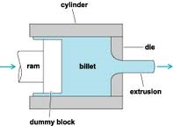
First module
Extrusion process

Slide 64
1- (over view) :
A-Target group:-
students of Technical College - Musayyib / Department of Agricultural Machinery and Equipment / third phase. B- Rationale:-
This unit is designed to introduce students to: - turning process and its determinants. C- Central ideas / To recognize the student to:
1 - the principle of the process of turning. 2 - the determinants of the process of turning. 3 - Turning machines

Slide 65
Note: 1. Each question three degree. 2. Please check that your answer review page (key answers to the tests) at the end of the module, in case you get the degree thus only 9 more needy to study this unit and go to the next unit of study. In case you have a degree less than 9 will need to study this unit.

Slide 66
Ministry of Higher Education and Scientific Research Board of Technical Education Technical College / Musayyib
Educational material for the bag manufacturing operations For students of Technical College - Musayyib Department of Agricultural Machinery and Equipment / Phase third
Preparation and design Ali Hassan Hamza Assistant Lecturer in Technical College / Musayyib 2011-2010

Slide 67
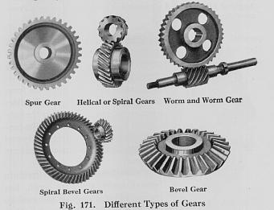
First module
Gears process

Slide 68
1- (over view) :
A-Target group:-
students of Technical College - Musayyib /Department of Agricultural Machinery and Equipment / third phase. B- Rationale:-
This unit is designed to introduce students to: - turning process and its determinants. C- Central ideas / To recognize the student to:
1 - the principle of the process of turning. 2 - the determinants of the process of turning. 3 - Turning machines

Slide 69
D- Objectives:-
student will be after the completion of the study the module able to: - A - recognize the gears process
C - chip resulting from the cutting process and its determinants

Slide 70
Ministry of Higher Education and Scientific Research Board of Technical Education Technical College / Musayyib
Educational material for the bag manufacturing operations For students of Technical College - Musayyib Department of Agricultural Machinery and Equipment / Phase third
Preparation and design Ali Hassan Hamza Assistant Lecturer in Technical College / Musayyib 2011-2010

Slide 71
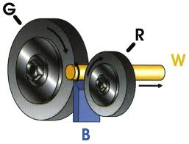
First module
Grinding process

Slide 72
1- (over view) :
A-Target group:-
students of Technical College - Musayyib / Department of Agricultural Machinery and Equipment / third phase. B- Rationale:-
This unit is designed to introduce students to: - turning process and its determinants. C- Central ideas / To recognize the student to:
1 - the principle of the process of turning. 2 - the determinants of the process of turning. 3 - Turning machines
D- Objectives:-
student will be after the completion of the study the module able to: - A - recognize the gears process
C - chip resulting from the cutting process and its determinants

Slide 73
Note: 1. Each question one degree. 2. Please check that your answer review page (key answers to the tests) at the end of the module, in case you get the degree thus only 9 more needy to study this unit and go to the next unit of study. In case you have a degree less than 9 will need to study this unit.

Slide 74
2- pre-testing
circle the letter preceding the correct answer for each of the following:
1 - The process (grinding ) from operations: - A - driver. B - formation. 2 - after a process (grinding) gets in the product: - A - decrease in size. B - Increase the volume. C - conservative on the size. 3 - the most important side effect of the process (grinding) are: - A - improve the mechanical properties of busy. B - Increasing the hardness of the surface is busy.

Slide 75
3- Display module

Slide 76
Grinding process For material removal, the method used in grinding is called abrasion. In other words, in grinding, an abrasive material rubs against the metal part and clears or removes tiny pieces of material. The process implies that instead of cutting like a lathe bit, the material is slowly and steadily worn away. This is because compared to the material being ground, the abrasive is harder. The grinding wheel actually acts like many hundreds of very small lathe bit, each cutting off some metal. The abrasive must be strong enough to bear any kind of forces acting upon it while grinding. Usually some sort of impact shock occurs when the abrasive comes in contact with the material. Grinding abrades material in a way similar to sanding. The grinding operation is performed on a several machines like the lathe and the mill, with the appropriate add-on accessories, the most important of which is the spindle.
Why grinding is necessary? Grinding is necessary for the following reasons: The material is too hard to be machined economically.
If the surface is adequately supported, grinding can produce flatness tolerances of less than ±0.0001 in. (±0.0025 mm) on a 5 x 5 in. (127 x 127 mm) steel surface.
Machining removes excessive material.
Grinding should be used when size tolerance specifications are beyond the capability of turning.
It is also applied if the requirements of surface finish is too tight for hard turning.

Slide 77
Types of grinding : - Grinding can be of various types, like as follows:
1- Surface grinding
1- Centered grinding
3- Center less grinding
4- Contour grinding
Surface grinding:-
This is perhaps the most fundamental of operations. Surface grinding is the process of providing precision ground surfaces either to a critical size or for the surface finish. In other words, it accurately processes or grounds a surface. Parts require surface grinding for various reasons like: Produce a flat surface.
For specifying accurate tolerance thickness.
A very smooth surface roughness is required.
For sharpening of cutting tool.

Slide 78
Centered grinding: -
In this type of grinding, the grinding is performed at the center. There are two types of centered grinding:-
1- Otsid diameter (OD) grinding. In Outside Diameter (OD) grinding , the work piece has center drilled ends, accommodating center points and surface is removed by rotating the grinder's face plate. With OD grinding the work piece and the grinding wheel moves or rotates in clockwise directions.
2- Inside Diameter (ID) grinding is performed on tubular parts that are generally held in a chuck or collect. The grinding wheel turns at very high speed to maintain the proper surface speed but it moves anticlockwise.

Slide 79
Contour grinding:
In case of contour grinding, the chopping function is used to grind the side face of a work piece.
center less grinder :-
Is classified according to the working range diameter and grinding wheel width: R50, R90 and R130. center less grinders are fixed-center grinders, solution which permit to simplify the change of part machining, the automation of loading-unloading and the CN control. The complete range of center less grinders have all CN controlled axes, the accuracy, and reliability of production is guarantee by grinding wheel spindle housed on hydrodynamic self-aligning bushings preloaded and adjusted to thermal expansion and double square hydrostatic slides.

Slide 80
production consists of:
1 Center less grinding machines for through feed and plunge grinding controlled by CNC
2 Straightening machines from coils to rods for medium and high tensile steel
3 Wire shaving machines from coil to coil for medium and high tensile steel
4 Automatic installations for cold working of wire
5 Service automation for centerless grinding machines and for rod working
6 Special automatic installations to work finished parts

Slide 82
Versatile and strong, it enables to straight either alloyed or carbon high resistance steel rounds. The metal wire pushed into the straightening drum, is pulled by the introduction rollers which let the wire advance freely, imparting only the pre-straightening bend. It’s the drum that, acting on a group of bushes mounted on plain bearings, bends and simultaneously, impart the desired advancement. The wire, thus straightened, passed across the extractor rollers witch are in rest position, and continues across the cutting bush. When the rod reaches the desired length, it will automatically cutted by a shearing machine. The extractor rollers, normally in rest position, and are driven only for the extraction of the last section of the wire.

Slide 84
shaving machine:-
Is the quick removal, from hot rolled wire coils, of a Surface layer (0,1- 0,6 mm) where are located cracks and decarburizations typical of Hot rolling process. No annealing nor pickling is requested and also grinding is avoided.
The total cost of this process can be 10 times less than traditional process.
The machine has been studied to meet increasing request of zero defects wire.
Typical applications: Spring, valve, stainless steels.
Loading, unloading and measuring automatic installations for bar grinding, for work finished parts and for wire cold working.

Slide 87
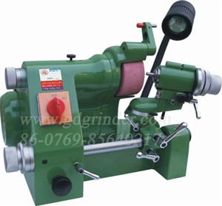
Universal cutter grinder:-
Cutter grinder U2 lathe tool post grinder
Universal cutter grinder(U3)
Engraving cutter grinder(GD-20)
More
Universal cutter grinder

Slide 88
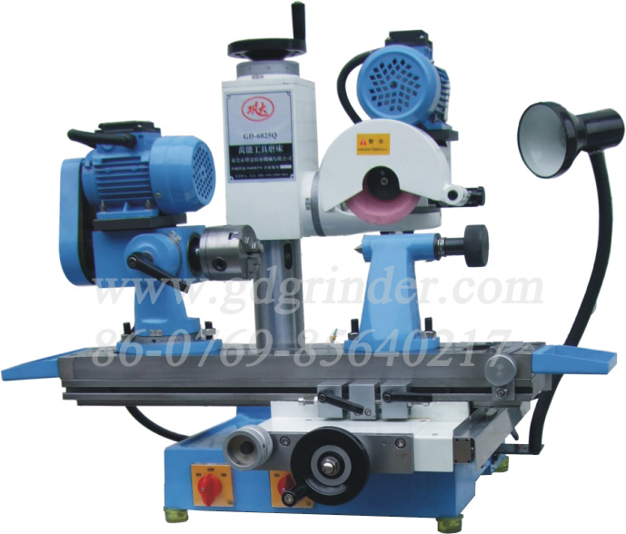
Grinder
SAW BLADE SHARPENER
Tool and cut Auto-tool tar grinder(GD-600S)
Tool grinder GD-6025Q
More

Slide 90
Post-test :-
Circle the letter preceding the correct answer for each of the following:
1 - by-products of the process () is: - A - Reich. B - oxidation surfaces. C - Changes the structure of the metal. 2 - dimensional measurements to Products process () are: - A - final. B - is infinite. 3 - called the operating tools used in the process (): - A - cutting tools. B - the formation of molds.

Slide 91
-: 2- pre-testing
Circle the letter preceding the correct answer for each of the following
1 - The process (gears ) from operations: - A - driver. B - formation. 2 - after a process (gears ) gets in the product: - A - decrease in size. B - Increase the volume. C - conservative on the size. 3 - the most important side effect of the process (gears ) are: - A - improve the mechanical properties of busy. B - Increasing the hardness of the surface is busy.

Slide 92
3- Display module

Slide 93
Note: 1. Each question one degree. 2. Please check that your answer review page (key answers to the tests) at the end of the module, in case you get the degree thus only 9 more needy to study this unit and go to the next unit of study. In case you have a degree less than 9 will need to study this unit.

Slide 94
Spur Gears
Spur gears are the most common type used. Tooth contact is primarily rolling, with sliding occurring during engagement : and disengagement. Some noise is normal, but it may become objectionable at high speeds.

Slide 95
Rack and Pinion.
Rack and pinion gears are essentially a linear shaped variation of spur gears The spur rack is a
portion of a spur gear with an infinite radius

Slide 96
Internal Ring Gear:
Internal gear is a cylindrical shaped gear with the meshing teeth inside or outside a circular ring. Often used with a spur gear. Internal ring gears may be used within a planetary gear arrangement.

Slide 97
-Helical Gear:
Helical gear is a cylindrical shaped gear with helicoids teeth. Helical gears operate with less noise and vibration than spur gears. At any time, the load on helical gears is distributed over several teeth, resulting in reduced wear. Due to their angular cut, teeth meshing results in thrust loads along the gear shaft. This action requires thrust bearings to absorb the thrust load and maintain gear alignment. They are widely used in industry. A negative is the axial thrust force the helix form causes.

Slide 98
Helical Rack Gear: Helical rack gears are linear shaped and meshes with a rotating helical gear.

Slide 99
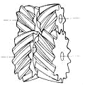
Double Helical Gear:
Double helical gear may have both left-hand and right-hand helical teeth. The double helical form is used to balance the thrust forces and provide additional gear shear area.

Slide 100
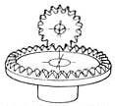
Face Gear:
Face gears are a circular disc with a ring of teeth cut on one side. The gear teeth are tapered toward the center of the tooth. These gears typically mate with a spur gear.

Slide 101
Worm Gear:
Worm gears teeth resembles ACME screw thread which mates with a helical gear, except that it is made to envelope the worm as seen along the worm's axis. Operation of worm gears is analogous to a screw. The relative motion between these gears is sliding rather than rolling. The uniform distribution of tooth pressures on these gears enables use of metals with inherently low coefficients of friction such as bronze wheel gears with hardened steel worm gears. These gears rely on full fluid film lubrication and require heavy oil compounded to enhance lubricity and film strength to prevent metal contact.

Slide 102
Double Enveloping Worm Gear:
The double enveloping worm gear has a radial changing pitch diameter. This increases the number and amount of tooth shear area.

Slide 103
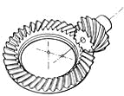
Hypoid Gear:
Hypoid gears are typically found within the differential (rear axle) of automobiles. The gear arrangement allows the translation of torque ninety degrees. Hypoid gears are similar to spiral bevel gears except that the shaft center lines do not intersect. Hypoid gears combine the rolling action and high tooth pressure of spiral bevels with the sliding action of worm gears. This combination and the all-steel construction of the drive and driven gear result in a gear set with special lubrication requirements, including oiliness and anti-weld additives to withstand the high tooth pressures and high rubbing speeds.

Slide 104
Straight Bevel Gear:
Straight bevel gears have tapered conical teeth which intersect the same tooth geometry. Bevel gears are used to transmit motion between shafts with intersecting center lines. The intersecting angle is normally 90 deg but may be as high as 180 deg. When the mating gears are equal in size and the shafts are positioned at 90 degrees to each other, they are referred to as miter gears. The teeth of bevel gears can also be cut in a curved manner to produce spiral bevel gears, which produce smoother and quieter operation than straight cut bevels

Slide 105
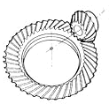
Bevel Gear:
Spiral bevel gears have a helical angle spiral teeth.

Slide 106
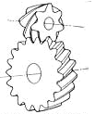
Screw Gear (Crossed Helical Gear): Screw gears are helical gears of opposite helix angle will mesh when their axes are crossed.

Slide 107
Post-test :-
Circle the letter preceding the correct answer for each of the following:
1 - by-products of the process () is: - A - Reich. B - oxidation surfaces. C - Changes the structure of the metal. 2 - dimensional measurements to Products process () are: - A - final. B - is infinite. 3 - called the operating tools used in the process (): - A - cutting tools. B - the formation of molds.

Slide 108
D- Objectives:-
student will be after the completion of the study the module able to: - A - recognize the gears process
C - chip resulting from the cutting process and its determinants

Slide 109
-: 2- pre-testing
Circle the letter preceding the correct answer for each of the following
1 - The process (Cutting ) from operations: - A - driver. B - formation. 2 - after a process (cutting ) gets in the product: - A - decrease in size. B - Increase the volume. C - conservative on the size. 3 - the most important side effect of the process (cutting ) are: - A - improve the mechanical properties of busy. B - Increasing the hardness of the surface is busy

Slide 110
3- Display module

Slide 111
Extrusion is a process used to create objects of a fixed cross-sectional profile. A material is pushed or drawn through a die of the desired cross-section. The two main advantages of this process over other manufacturing processes are its ability to create very complex cross-sections and work materials that are brittle, because the material only encounters compressive and shear stresses. It also forms finished parts with an excellent surface finish.
Extrusion may be continuous (theoretically producing indefinitely long material) or semi-continuous (producing many pieces). The extrusion process can be done with the material hot or cold.
Commonly extruded materials include metals, polymers, ceramics, concrete and foodstuffs.
Hollow cavities within extruded material cannot be produced using a simple flat extrusion die, because there would be no way to support the center barrier of the die. Instead, the die assumes the shape of a block with depth, beginning first with a shape profile that supports the center section. The die shape then internally changes along its length into the final shape, with the suspended center pieces supported from the back of the die.

Slide 112
Extruded aluminum with several hollow cavities; slots allow bars to be joined with special connectors.

Slide 113
Process
The process begins by heating the stock material (for hot or warm extrusion). It is then loaded into the container in the press. A dummy block is placed behind it where the ram then presses on the material to push it out of the die. Afterward the extrusion is stretched in order to straighten it. If better properties are required then it may be heat treated or cold worked.
The extrusion ratio is defined as the starting cross-sectional area divided by the cross-sectional area of the final extrusion. One of the main advantages of the extrusion process is that this ratio can be very large while still producing quality parts.

Slide 114
Hot extrusion
Hot extrusion is a hot working process, which means it is done above the material's recrystallization temperature to keep the material from work hardening and to make it easier to push the material through the die. Most hot extrusions are done on horizontal hydraulic presses that range from 230 to 11,000 metric tons (250 to 12,000 short tons). Pressures range from 30 to 700 Map. (4,400 to 100,000 psi), therefore lubrication is required, which can be oil or graphite for lower temperature extrusions, or glass powder for higher temperature extrusions. The biggest disadvantage of this process is its cost for machinery and its upkeep.

Slide 115
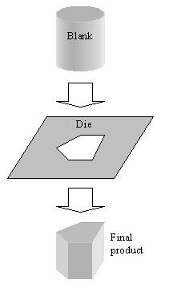

Slide 116
Hot extrusion temperature for various metals
Material | Temperature [°C (°F)]
Magnesium | 350-450 (650-850)
Aluminum | 350-500 (650-900)
Copper | 600-1100 (1200-2000)
Steel | 1200-1300 (2200–2400)
Titanium | 700-1200 (1300-2100)
Nickel | 1000-1200 (1900–2200)
Refractory alloys | up to 2000 (4000)

Slide 117
The extrusion process is generally economical when producing between several kilograms (pounds) and many tons, depending on the material being extruded. There is a crossover point where roll forming becomes more economical. For instance, some steels become more economical to roll if producing more than 20,000 kg (50,000 lb).^{[2]}
Aluminum hot extrusion die.
extrusion
Cold extrusion is done at room temperature or near room temperature. The advantages of this over hot extrusion are the lack of oxidation, higher strength due to cold working, closer tolerances, good surface finish, and fast extrusion speeds if the material is subject to hot shortness.^{[1]}
Materials that are commonly cold extruded include: lead, tin, aluminum, copper, zirconium, titanium, molybdenum, beryllium, vanadium, niobium, and steel.
Examples of products produced by this process are: collapsible tubes, fire extinguisher cases, shock absorber cylinders, automotive pistons, and gear blanks.

Slide 118
Warm extrusion is done above room temperature, but below the re-crystallization temperature of the material the temperatures ranges from 800 to 1800 °F (424 to 975 °C). It is usually used to achieve the proper balance of required forces, ductility and final extrusion properties.
Equipment
There are many different variations of extrusion equipment. They vary by four major characteristics:
Movement of the extrusion with relation to the ram. If the die is held stationary and the ram moves towards it then its called "direct extrusion". If the ram is held stationary and the die moves towards the ram its called "indirect extrusion".
The position of the press, either vertical or horizontal.
The type of drive, either hydraulic or mechanical.
The type of load applied, either conventional (variable) or hydrostatic.
A single or twin screw auger, powered by an electric motor, or a ram, driven by hydraulic pressure (often used for steel and titanium alloys), oil pressure (for aluminum), or in other specialized processes such as rollers inside a perforated drum for the production of many simultaneous streams of material.
Typical extrusion presses cost more than $100,000, whereas dies can cost up to $2000.

Slide 119
Direct extrusion
Direct extrusion, also known as forward extrusion, is the most common extrusion process. It works by placing the billet in a heavy walled container. The billet is pushed through the die by a ram or screw. There is a reusable dummy block between the ram and the billet to keep them separated. The major disadvantage of this process is that the force required to extrude the billet is greater than that need in the indirect extrusion process because of the frictional forces introduced by the need for the billet to travel the entire length of the container. Because of this the greatest force required is at the beginning of process and slowly decreases as the billet is used up. At the end of the billet the force greatly increases because the billet is thin and the material must flow radically to exit the die. The end of the billet (called the butt end) is not used for this reason.

Slide 120
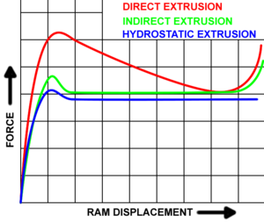
Plot of forces required by various extrusion processes.

Slide 121
Indirect extrusion
In indirect extrusion, also known as backwards extrusion, the billet and container move together while the die is stationary. The die is held in place by a "stem" which has to be longer than the container length. The maximum length of the extrusion is ultimately dictated by the column strength of the stem. Because the billet moves with the container the frictional forces are eliminated. This leads to the following
advantages:
A 25 to 30% reduction of friction, which allows for extruding larger billets, increasing speed, and an increased ability to extrude smaller cross-sections
There is less of a tendency for extrusions to crack because there is no heat formed from friction
The container liner will last longer due to less wear
The billet is used more uniformly so extrusion defects and coarse grained peripherals zones are less likely.

Slide 122
The disadvantages are:
Impurities and defects on the surface of the billet affect the surface of the extrusion. These defects ruin the piece if it needs to be anodized or the aesthetics are important. In order to get around this the billets may be wire brushed, machined or chemically cleaned before being used.
This process isn't as versatile as direct extrusions because the cross-sectional area is limited by the maximum size of the stem.

Slide 123
Extrusion defects
Surface cracking - When the surface of an extrusion splits. This is often caused by the extrusion temperature, friction, or speed being too high. It can also happen at lower temperatures if the extruded product temporarily sticks to the die.
Pipe - A flow pattern that draws the surface oxides and impurities to the center of the product. Such a pattern is often caused by high friction or cooling of the outer regions of the billet.
Internal cracking - When the center of the extrusion develops cracks or voids. These cracks are attributed to a state of hydrostatic tensile stress at the centerline in the deformation zone in the die. (A similar situation to the necked region in a tensile stress specimen)
Surface lines - When there are lines visible on the surface of the extruded profile. This depends heavily on the quality of the die production and how well the die is maintained, as some residues of the material extruded can stick to the die surface and produce the embossed lines.

Slide 124
Metal
Metals that are commonly extruded include:
Aluminum is the most commonly extruded material. Aluminum can be hot or cold extruded. If it is hot extruded it is heated to 575 to 1100 °F (300 to 600 °C). Examples of products include profiles for tracks, frames, rails, mullions, and heat sinks.
Copper (1100 to 1825 °F (600 to 1000 °C)) pipe, wire, rods, bars, tubes, and welding electrodes. Often more than 100 ksi (690 MPa) is required to extrude copper.
Lead and tin (maximum 575 °F (300 °C)) pipes, wire, tubes, and cable sheathing. Molten lead may also be used in place of billets on vertical extrusion presses.
Magnesium (575 to 1100 °F (300 to 600 °C)) aircraft parts and nuclear industry parts. Magnesium is about as extrudable as aluminum.
Zinc (400 to 650 °F (200 to 350 °C)) rods, bar, tubes, hardware components, fitting, and handrails.
Steel (1825 to 2375 °F (1000 to 1300 °C)) rods and tracks. Usually plain carbon steel is extruded, but alloy steel and stainless steel can also be extruded.
Titanium (1100 to 1825 °F (600 to 1000 °C)) aircraft components including seat tracks, engine rings, and other structural par

Slide 125
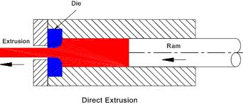

Slide 126
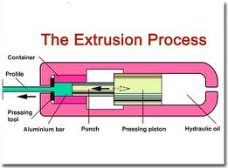

Slide 127
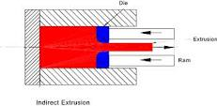

Slide 128
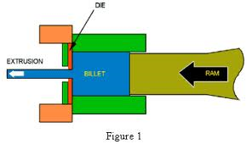

Slide 129
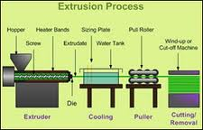

Slide 130
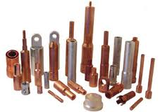
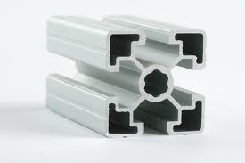

Slide 131
Impact extrusion is a subset process of cold forging that is defined as a compressive metal deformation process conducted at room temperature. Deformation is achieved by applying a tremendous amount of force to a billet by use of a mechanical or hydraulic press.
Many materials can be impacted with good results. Aluminum and medium-to-low carbon steel are the most common metals used, with copper and magnesium impacted in less frequent applications. Titanium and stainless steel can be impacted under certain conditions, but deformation is more limited than what is achievable with the other alloys.

Slide 132
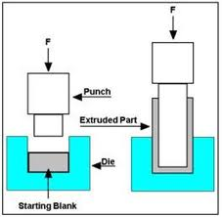
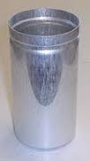
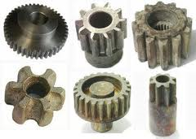
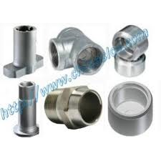
Backward impact
Cold impact extrusion screening cans are still the most cost effective ...

Slide 133
Post-test :-
Circle the letter preceding the correct answer for each of the following:
1 - by-products of the process (extrusion) is: - A - Reich. B - oxidation surfaces. C - Changes the structure of the metal. 2 - dimensional measurements to Products process (extrusion) are: - A - final. B - is infinite. 3 - called the operating tools used in the process (extrusion): - A - cutting tools. B - the formation of molds.

Slide 134
2- pre-testing
Circle the letter preceding the correct answer for each of the following:
1 - The process (Cutting ) from operations: - A - driver. B - formation. 2 - after a process (cutting ) gets in the product: - A - decrease in size. B - Increase the volume. C - conservative on the size. 3 - the most important side effect of the process (cutting ) are: - A - improve the mechanical properties of busy. B - Increasing the hardness of the surface is busy

Slide 135
Note: 1. Each question one degree. 2. Please check that your answer review page (key answers to the tests) at the end of the module, in case you get the degree thus only 9 more needy to study this unit and go to the next unit of study. In case you have a degree less than 9 will need to study this unit.

Slide 136
3- Display module

Slide 137
Drilling is a cutting process that uses a drill bit to cut or enlarge a hole in solid materials. The drill bit is a multipoint, end cutting tool. It cuts by applying pressure and rotation to the work piece, which forms chips at the cutting edge.
Process
Drilled holes are characterized by their sharp edge on the entrance side and the presence of burrs on the exit side (unless they have been removed). Also, the inside of the hole usually has helical feed marks.^{[1]}
Drilling may affect the mechanical properties of the work piece by creating low residual stresses around the hole opening and a very thin layer of highly stressed and disturbed material on the newly formed surface. This causes the work piece to
become more susceptible to corrosion at the stressed surface

Slide 138
For fluted drill bits, any chips are removed via the flutes. Chips may be long spirals or small flakes, depending on the material, and process parameters. The type of chips formed can be an indicator of the machine ability of the material, with long gummy chips reducing machine ability.
When possible drilled holes should be located perpendicular to the work piece surface. This minimizes the drill bit's tendency to "walk", that is, to be deflected, which causes the hole to be misplaced. The higher the length-to-diameter ratio of the drill bit, the higher the tendency to walk. The tendency to walk is also preempted in various other ways, which include:

Slide 139
Casting, molding, or forging a mark into the work piece
Center punching
Spot drilling (i.e., center drilling)
Spot facing, which is facing a certain area on a rough casting or forging to establish, essentially, an island of precisely known surface in a sea of imprecisely known surface
Constraining the position of the drill bit using a drill jig with drill bushings
Surface finish in drilling may range from 32 to 500 micro inches. Finish cuts will generate surfaces near 32 micro inches, and roughing will be near 500 micro inches.
Cutting fluid is commonly used to cool the drill bit, increase tool life, increase speeds and feeds, increase the surface finish, and aid in ejecting chips. Application of these fluids is usually done by flooding the work piece or by applying a spray mist.^{[1]}
In deciding which drill(s) to use it is important to consider the task at hand and evaluate which drill would best accomplish the task. There are a variety of drill styles that each serve a different purpose. The sub land drill is capable of drilling more than one diameter. The spade drill is used to drill larger hole sizes. The index able drill is useful in managing chips.^{[1]}
Establishing a centering mark or feature before drilling, such as by

Slide 140
Spot drilling
The purpose of spot drilling is to drill a hole that will act as a guide for drilling the final hole. The hole is only drilled part way into the work piece because it is only used to guide the beginning of the next drilling process.
Center drilling
The purpose of center drilling is to drill a hole that will act as a center of rotation for possible following operations. Center drilling is typically performed using a drill with a special shape, known as a center drill
Deep hole drilling
Deep hole drilling is defined as a hole depth greater than five times the diameter of the hole.^{[2]} These types of holes require special equipment to maintain the straightness and tolerances. Other considerations are roundness and surface finish.
Deep hole drilling is generally achievable with a few tooling methods, usually gun drilling or BTA drilling. These are differentiated due to the coolant entry method (internal or external) and chip removal method (internal or external). Secondary tooling methods include trepanning, skiving and burnishing, pull boring, or bottle boring.
A high tech monitoring system is used to control force, torque, vibrations, and acoustic emission. The vibration is considered a major defect in deep hole drilling which can often cause the drill to break. Special coolant is usually used to aid in this type of drilling

Slide 141
Trepanning
Trepanning is commonly used for creating larger diameter holes (up to 915 mm (36.0 in)) where a standard drill bit is not feasible or economical. Trepanning removes the desired diameter by cutting out a solid disk similar to the workings of a drafting compass. Trepanning is performed on flat products such as sheet metal, granite (curling stone), plates, or structural members like I-beams. Trepanning can also be useful to make grooves for inserting seals, such as O-rings.
Micro drilling
Micro drilling refers to the drilling of holes less than 0.5 mm (0.020 in). Drilling of holes at this small diameter presents greater problems since coolant fed drills cannot be used and high spindle speeds are required. High spindle speeds that exceed 10,000 RPM also require the use of balanced tool holders

Slide 142
Drilling in metal
Under normal usage, swarf is carried up and away from the tip of the drill bit by the fluting of the drill bit. The cutting edges produce more chips which continue the movement of the chips outwards from the hole. This is successful until the chips pack too tightly, either because of deeper than normal holes or insufficient backing off (removing the drill slightly or totally from the hole while drilling). Cutting fluid is sometimes used to ease this problem and to prolong the tool's life by cooling and lubricating the tip and chip flow. Coolant may be introduced via holes through the drill shank, which is common when using a gun drill. When cutting aluminum in particular, cutting fluid helps ensure a smooth and accurate hole while preventing the metal from grabbing the drill bit in the process of drilling the hole.
For heavy feeds and comparatively deep holes oil-hole drills can be used, with a lubricant pumped to the drill head through a small hole in the bit and flowing out along the fluting. A conventional drill press arrangement can be used in oil-hole drilling, but it is more commonly seen in automatic drilling machinery in which it is the work piece that rotates rather than the drill bit.

Slide 143
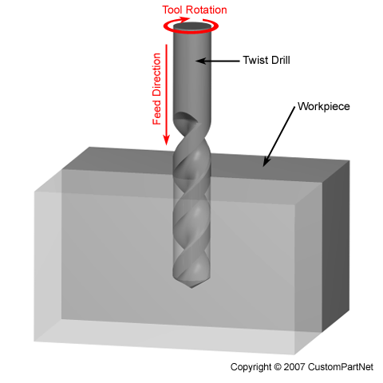

Slide 144
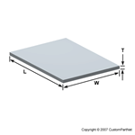
Machining
Machining is a term used to describe a variety of material removal processes in which a cutting tool removes unwanted material from a work piece to produce the desired shape. The work piece is typically cut from a larger piece of stock, which is available in a variety of standard shapes, such as flat sheets, solid bars, hollow tubes, and shaped beams. Machining can also be performed on an existing part, such as a casting or forging.

Slide 145
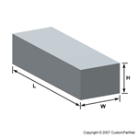

Slide 146
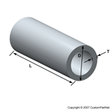
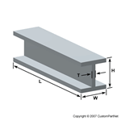
Parts that are machined from a pre-shaped work piece are typically cubic or cylindrical in their overall shape, but their individual features may be quite complex. Machining can be used to create a variety of features including holes, slots, pockets, flat surfaces, and even complex surface contours. Also, while machined parts are typically metal, almost all materials can be machined, including metals, plastics, composites, and wood. For these reasons, machining is often considered the most common and versatile of all manufacturing processes.

Slide 147
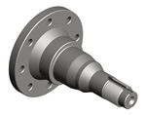
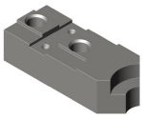

Slide 148
Related processes
The following are some related processes that often accompany drilling:
Counterboring
This process creates a stepped hole in which a larger diameter follows a smaller diameter partially into a hole.
Countersinking
This process is similar to counterboring but the step in the hole is cone-shaped.
Boring
Boring precisely enlarges an already existing hole using a single point cutter.
Friction drilling
drilling holes using plastic deformation of the subject (under heat and pressure) instead of cutting it.

Slide 149
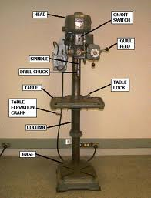
Machines of drilling

Slide 154
Drilling Speed and Feed Calculator
Determine the spindle speed (RPM) and feed rate (IPM) for a drilling operation, as well as the cut time for a given cut length. Drilling operations are those in which a cutting tool with sharp teeth, such as a twist drill, rotates and feeds into the workpiece axially, forming a hole with a diameter equal to that of the tool. Calculations use the desired tool diameter, cutting speed, and cutting feed, which should be chosen based on the specific cutting conditions, including the workpiece material and tool material.

Slide 155
Drilling Speed and Feed Calculator
Tool diameter (in):
Cutting speed (SFM)---------- × 12 |  | ÷ | Tool diameter (in) × π | = | Spindle speed (RPM)
Cutting feed (IPR) |  | × | Spindle speed (RPM) | = | Feed rate (IPM)
Cut length (in) |  | ÷ | Feed rate (IPM) | = | Cut time (min)

Slide 157
Post-test :-
Circle the letter preceding the correct answer for each of the following:
1 - by-products of the process (drilling) is: - A - Reich. B - oxidation surfaces. C - Changes the structure of the metal. 2 - dimensional measurements to Products process (drilling) are: - A - final. B - is infinite. 3 - called the operating tools used in the process (drilling): - A - cutting tools. B - the formation of molds.

Slide 158
Ministry of Higher Education and Scientific Research Board of Technical Education Technical College / Musayyib
Educational material for the bag manufacturing operations For students of Technical College - Musayyib Department of Agricultural Machinery and Equipment / Phase third
Preparation and design Ali Hassan Hamza Assistant Lecturer in Technical College / Musayyib 2011-2010

Slide 159
First module
planning process

Slide 160
1- (over view)
A-Target group:-
students of Technical College - Musayyib / Department of Agricultural Machinery and Equipment / third phase. B- Rationale:-
This unit is designed to introduce students to: - turning process and its determinants. C- Central ideas / To recognize the student to:
1 - the principle of the process of turning. 2 - the determinants of the process of turning. 3 - Turning machines

Slide 161
D- Objectives:-
student will be after the completion of the study the module able to: - A - recognize the gears process
C - chip resulting from the cutting process and its determinants

Slide 162
2- pre-testing
Circle the letter preceding the correct answer for each of the
following
1 - The process (planning ) from operations: - A - driver. B - formation. 2 - after a process (planning) gets in the product: - A - decrease in size. B - Increase the volume. C - conservative on the size. 3 - the most important side effect of the process (planning) are: - A - improve the mechanical properties of busy. B - Increasing the hardness of the surface is busy.

Slide 163
Note: 1. Each question three degree. 2. Please check that your answer review page (key answers to the tests) at the end of the module, in case you get the degree thus only 9 more needy to study this unit and go to the next unit of study. In case you have a degree less than 9 will need to study this unit.

Slide 164
3- Display module

Slide 165
Planning is a manufacturing process of material removal in which the work piece reciprocates against a stationary single-point cutting tool producing a plane or sculpted surface. Planning is analogous to shaping. The main difference between these two processes is that in shaping the tool reciprocates across the stationary work piece. Planning motion is the opposite of shaping. Both planning and shaping are rapidly being replaced by milling.
The mechanism used for this process is known as a planer. The size of the planer is determined by the largest work piece that can be machined on it. The cutting tools are usually carbide tipped or made of high speed steel and resemble those used in facing and turning
.

Slide 166
Process :-
Uses single-point cutting tools •Involves a reciprocating motion between the tool and work piece •Produces plane or sculpted surfaces •Leaves parallel feed marks
In shaping, the tool is brought into position with the work piece. The tool then repeatedly moves in a straight line while the work piece is incrementally fed into the line of motion of the tool, this produces a flat, smooth, and sculpted surface. For shaped pieces the tool reciprocates across the stationary work piece.

Slide 167
.
The tools are usually tilted or lifted after each stroke. This is done hydraulically or manually in order to prevent the tool surface from chipping when the work piece travels back across
Work piece Geometry Planning can be used to produce flat surfaces, as well as cross-sections with grooves and notches, are produced along the length of work piece. Shaping is basically the same as planning, except the work piece is usually smaller, and it is the tool that moves and not the work piece. Planning can be used to produce horizontal, vertical, or inclined flat surfaces on work pieces usually too large for shaping. Shaping is used not only for flat surfaces, but also for external or internal surfaces (either horizontal or inclined). Curved and irregular surfaces can also be produced by using special attachments

Slide 169
Setup and Equipment
Flat, angular, and contoured surfaces are made by horizontal shapers. Concerning shaping, the device that holds the piece being worked on has a very heavy movable jaw to withstand cutting forces. The size of the planer needed is determined by the work piece. Depending on the size of the work piece many clamps and supporting devices may be used to hold it on the planer.
Typical Tools and Geometry Produced
The tools for shaping/planning are usually made of high speed steel or carbide tipped. Except for some slight angle difference, cutting tools resemble those used in facing and turning. Some advantages of using single-point cutting tools over multipoint tools is that they are more easily sharpened and fabricated. Internal shapes can be made by using a special extension tool

Slide 171
Post-test :-
Circle the letter preceding the correct answer for each of the following:
1 - by-products of the process () is: - A - Reich. B - oxidation surfaces. C - Changes the structure of the metal. 2 - dimensional measurements to Products process () are: - A - final. B - is infinite. 3 - called the operating tools used in the process (): - A - cutting tools. B - the formation of molds.

Slide 172
Ministry of Higher Education and Scientific Research Board of Technical Education Technical College / Musayyib
Educational material for the bag manufacturing operations For students of Technical College - Musayyib Department of Agricultural Machinery and Equipment / Phase third
Preparation and design Ali Hassan Hamza Assistant Lecturer in Technical College / Musayyib 2011-2010

Slide 173
First module
Rolling process

Slide 174
1- (over view) :
A-Target group:-
students of Technical College - Musayyib / Department of Agricultural Machinery and Equipment / third phase. B- Rationale:-
This unit is designed to introduce students to: - turning process and its determinants. C- Central ideas / To recognize the student to:
1 - the principle of the process of turning. 2 - the determinants of the process of turning. 3 - Turning machines
D- Objectives:-
student will be after the completion of the study the module able to: - 1 - recognize the gears process
2 - chip resulting from the cutting process and its determinants

Slide 175
2- pre-testing
Circle the letter preceding the correct answer for each of the following
1 - The process (rolling ) from operations: - A - driver. B - formation. 2 - after a process (rolling) gets in the product: - A - decrease in size. B - Increase the volume. C - conservative on the size. 3 - the most important side effect of the process (rolling) are: - A - improve the mechanical properties of busy. B - Increasing the hardness of the surface is busy.

Slide 176
Note: 1. Each question one degree. 2. Please check that your answer review page (key answers to the tests) at the end of the module, in case you get the degree thus only 9 more needy to study this unit and go to the next unit of study. In case you have a degree less than 9 will need to study this unit.

Slide 177
3- Display module

Slide 178
Rolling is a metal forming process in which metal stock is passed through a pair of rolls. Rolling is classified according to the temperature of the metal rolled. If the temperature of the metal is above its re crystallization temperature, then the process is termed as
hot rolling. If the temperature of the metal is below its re crystallization temperature, the process is termed as cold rolling. In terms of usage, hot rolling processes more tonnage than any other manufacturing process and cold rolling processes the most tonnage out of all cold working processes.
There are many types of rolling processes, including flat rolling, foil rolling, ring rolling, roll bending, roll forming, profile rolling, and controlled rolling.

Slide 179
Hot and cold rolling
Hot rolling
Hot rolling is a metalworking process that occurs above the re crystallization temperature of the material. After the grains deform during processing, they re crystallize, which maintains an equaled microstructure and prevents the metal from work hardening. The starting material is usually large pieces of metal, like semi-finished casting products, such as slabs, blooms, and billets. If these products came from a continuous casting operation the products are usually fed directly into the rolling mills at the proper temperature. In smaller operations the material starts at room temperature and must be heated. This is done in a gas- or oil-fired soaking pit for larger work pieces and for smaller work pieces induction heating is used. As the material is worked the temperature must be monitored to make sure it remains above the re crystallization temperature. To maintain a safety factor a finishing temperature is defined above the re crystallization temperature; this is usually 50 to 100 °C (122 to 212 °F) above the re crystallization temperature. If the temperature does drop below this temperature the material must be re-heated before more hot rolling.]

Slide 180
Hot rolled metals generally have little directionality in their mechanical properties and deformation induced residual stresses. However, in certain instances non-metallic inclusions will impart some directionality and work pieces less than 20 mm (0.79 in) thick often have some directional properties. Also, non-uniformed cooling will induce a lot of residual stresses, which usually occurs in shapes that have a non-uniform cross-section, such as I-beams and H-beams. While the finished product is of good quality, the surface is covered in mill scale, which is an oxide that forms at high-temperatures. It is usually removed via pickling or the smooth clean surface process, which reveals a smooth surface. Dimensional tolerances are usually 2 to 5% of the overall dimension.
Hot rolling is used mainly to produce sheet metal or simple cross sections, such as rail tracks.

Slide 181
Cold rolling
Cold rolling occurs with the metal below its re crystallization temperature (usually at room temperature), which increases the strength via strain hardening up to 20%. It also improves the surface finish and holds tighter tolerances. Commonly cold-rolled products include sheets, strips, bars, and rods; these products are usually smaller than the same products that are hot rolled. Because of the smaller size of the work pieces and their greater strength, as compared to hot rolled stock, four-high or cluster mills are used. Cold rolling cannot reduce the thickness of a work piece as much as hot rolling in a single pass.
Cold-rolled sheets and strips come in various conditions: full-hard, half-hard, quarter-hard, and skin-rolled. Full-hard rolling reduces the thickness by 50%, while the others involve less of a reduction. Quarter-hard is defined by its ability to be bent back onto itself along the grain boundary without breaking. Half-hard can be bent 90°, while full-hard can only be bent 45°, with the bend radius approximately equal to the material thickness. Skin-rolling, also known as a skin-pass, involves the least amount of reduction: 0.5-1%. It is used to produce a smooth surface, a uniform thickness, and reduce the yield-point phenomenon (by preventing Lauder bands from forming in later processing). It is also used to breakup the spangles in galvanized steel. Skin-rolled stock is usually used in subsequent cold-working processes where good ductility is required.

Slide 182
Other shapes can be cold-rolled if the cross-section is relatively uniform and the transverse dimension is relatively small; approximately less than 50 mm (2.0 in). This may be a cost-effective alternative to extruding or machining the profile if the volume is in the several tons or more. Cold rolling shapes requires a series of shaping operations, usually along the lines of: sizing, breakdown, roughing, semi-roughing, semi-finishing, and finishing.

Slide 183
Processes
Roll bending
Roll bending produces a cylindrical shaped product from plate or steel metal
.

Slide 184
Roll forming
Roll forming is a continuous bending operation in which a long strip of metal (typically coiled steel) is passed through consecutive sets of rolls, or stands, each performing only an incremental part of the bend, until the desired cross-section profile is obtained. Roll forming is ideal for producing parts with long lengths or in large quantities. There are mainly 3 main processes, 4 rollers, 3 rollers and 2 rollers, and have different advantages according to the specifications of the plate (thickness length and diameter) and the shapes.
Also call roll bending or plate rolling process this is used in many fields, Exhaust pipes, Trucks brakes, Pressure Vessel Tanks Gas tanks, Components for airbags, Fire extinguishers, Hot water boilers, Drawer rails, Filter housings, Fittings, Fuel filters, Gear components, Gear selector forks, Multi diameter Shells, Pressurized containers, Pumps' shells, Rear axles, Sink mountings, Spinning compatible tubes, Washing drums.

Slide 185
Flat rolling
Flat rolling is the most basic form of rolling with the starting and ending material having a rectangular cross-section. The material is fed in between two rollers, called working rolls, that rotate in opposite directions. The gap between the two rolls is less than the thickness of the starting material, which causes it to deform. The decrease in material thickness causes the material to elongate. The friction at the interface between the material and the rolls causes the material to be pushed through. The amount of deformation possible in a single pass is limited by the friction between the rolls; if the change in thickness is too great the rolls just slip over the material and do not draw it in. The final product is either sheet or plate, with the former being less than 6 mm (0.24 in) thick and the latter greater than; however, heavy plates tend to be formed using a press, which is termed forming, rather than rolling.
Oftentimes the rolls are heated to assist in the workability of the metal. Lubrication is often used to keep the work piece from sticking to the rolls. To fine tune the process the speed of the rolls and the temperature of the rollers are adjusted.

Slide 187
Foil rolling
Foil rolling is a specialized type of flat rolling, specifically used to produce foil, which is sheet metal with a thickness less than 200 µm (0.0079 in). The rolling is done in a cluster mill because the small thickness requires a small diameter rolls .To reduce the need for small rolls pack rolling is used, which rolls multiple sheets together to increase the effective starting thickness. As the foil sheets come through the rollers, they are trimmed and slatted with circular or razor-like knives. Trimming refers to the edges of the foil, while slitting involves cutting it into several sheets. Aluminum foil is the most commonly produced product via pack rolling. This is evident from the two different surface finishes; the shiny side is on the roll side and the dull side is against the other sheet of foil.

Slide 188
Ring rolling
Ring rolling is a specialized type of hot rolling that increases the diameter of a ring. The starting material is a thick-walled ring. This work piece is placed on an idler roll, while another roll, called the driven roll, presses the ring from the outside. As the rolling occurs the wall thickness decreases as the diameter increases. The rolls may be shaped to form various cross-sectional shapes. The resulting grain structure is circumferential, which gives better mechanical properties. Diameters can be as large as 8 m (26 ft) and face heights as tall as 2 m (79 in). Common applications include rockets, turbines, airplanes, pipes, and pressure vessels

Slide 190
Structural shape rolling
Structural shape rolling, also known as shape rolling and profile rolling, is a metal forming process where structural shapes are passed through rollers to bend or deform the work piece to a desired shape while maintaining a constant cross-section. Structural shapes that can be rolled include: I-beams, H-beams, T-beams, U-beams, angle iron, channels, bar stock, and railroad rails. The most commonly rolled material is structural steel, however other include metals, plastic, paper, and glass. Common applications include: railroads, bridges, roller coasters, art, and architectural applications.
It is a cost effective way of bending this kind of material because the process requires less set-up time and uses pre-made dies that are changed out according to the shape and dimension of the work piece . This process can roll work pieces into full circles.

Slide 192
Rolling machine :-Different models of rolling machine with capacity scope as below:
1- max rolling thickness from 12mm to 160mm
2- max rolling width: from 2000mm to 5000mm
3- motor power: from 5.5kw to 180kw

Slide 194
Cold Rolling Mill Line
Cold rolling occurs with the metal below its re- crystallization temperature (usually at room temperature),
which increases the strength via strain hardening up to 20%.
It also improves the surface finish and holds tighter tolerance.
Commonly cold rolled products include sheets, strips, bars, and rods;
these products are usually smaller than the same products that are hot rolled.
Cold rolling cannot reduce the thickness of a work- piece as much as hot rolling in a single pass.

Slide 196
Post-test :-
Circle the letter preceding the correct answer for each of the following:
1 - by-products of the process (rolling) is: - A - Chips . B - oxidation surfaces. C - Changes the structure of the metal. 2 - dimensional measurements to Products process (rolling) are: - A - final. B- is infinite. 3 - called the operating tools used in the process (rolling): - A - cutting tools. B - the formation of molds.

Slide 197
Ministry of Higher Education and Scientific Research Board of Technical Education Technical College / Musayyib
Educational material for the bag manufacturing operations For students of Technical College - Musayyib Department of Agricultural Machinery and Equipment / Phase III
Preparation and design Ali Hassan Hamza Assistant Lecturer in Technical College / Musayyib 2011-2010

Slide 198
First module
turning process

Slide 199
1- (over view) :
A-Target group:-
students of Technical College - Musayyib / Department of Agricultural Machinery and Equipment / third phase. B- Rationale:-
This unit is designed to introduce students to: - turning process and its determinants. C- Central ideas / To recognize the student to:
1 - the principle of the process of turning. 2 - the determinants of the process of turning. 3 - Turning machines
D- Objectives:-
student will be after the completion of the study the module able to: - A - recognize the gears process
C - chip resulting from the cutting process and its determinants

Slide 200
2- pre-testing
Circle the letter preceding the correct answer for each of the following:
1 - The process (turning ) from operations: - A - driver. B - formation. 2 - after a process (turning ) gets in the product: - A - decrease in size. B - Increase the volume. C - conservative on the size. 3 - the most important side effect of the process (turning ) are: - A - improve the mechanical properties of busy. B - Increasing the hardness of the surface is busy.

Slide 201
Note: 1. Each question three degree. 2. Please check that your answer review page (key answers to the tests) at the end of the module, in case you get the degree thus only 9 more needy to study this unit and go to the next unit of study. In case you have a degree less than 9 will need to study this unit.

Slide 202
3- Display module

Slide 203
Turning Speed and Feed Calculator:-
Determine the spindle speed (RPM) and feed rate (IPM) for a turning operation, as well as the cut time for a given cut length. Turning operations remove material from a rotating work piece by feeding a single-point cutting tool axially, along the side of the work piece. Calculations use the desired cut diameter, cutting speed, and cutting feed, which should be chosen based on the specific cutting conditions, including the work piece material and tool material..

Slide 204
In some turning operations, the diameter of the work piece will change so the spindle speed and cutting speed (SFM) must change as well. Typically, values are calculated for a single cut diameter and then either the spindle speed or cutting speed is held constant while the other varies. Learn more about Turning

Slide 205
Turning Speed and Feed Calculator
Cut diameter (in):
Cutting speed (SFM) × 12 | ÷ | Cut diameter (in) × π | = | Spindle speed (RPM)
Cutting feed (IPR) | × | Spindle speed (RPM) | = | Feed rate (IPM)
Cut length (in) | ÷ | Feed rate (IPM) | = | Cut time (min)

Slide 207
Turning Surface Roughness Calculator
Calculate the surface roughness for a turning operation based on the tool nose radius and the cutting feed (IPR). Single-point cutting tools used for finishing operations have a rounded front corner, or "nose", which forms small peaks and valleys in the material as the tool feeds along the rotating work piece. The height of these surface variations define the surface roughness, which can be measured as an arithmetic average (Ra) or an RMS value. Learn more about Turning.

Slide 208
Turning Surface Roughness Calculator
Cutting feed (IPR) ² | ÷ | Tool nose radius (in) × 24 | = | Ra surface roughness (μin) ÷ 1000000
Ra surface roughness (μin) | × | 1.11 | = | RMS surface roughness (μin)

Slide 210
Turning is a form of machining, a material removal process, which is used to create rotational parts by cutting away unwanted material. The turning process requires a turning machine or lathe,, fixture, and cutting tool. The work piece is a work piece of pre-shaped material that is secured to the fixture, which itself is attached to the turning machine, and allowed to rotate at high speeds..
cutter is typically a single-point cutting tool that is also secured in the machine, although some operations make use of multi-point tools. The cutting tool feeds into the rotating work piece and cuts away material in the form of small chips to create the desired shape

Slide 211
Turning is used to produce rotational, typically axi-symmetric, parts that have many features, such as holes, grooves, threads, tapers, various diameter steps, and even contoured surfaces. Parts that are fabricated completely through turning often include components that are used in limited quantities, perhaps for prototypes, such as custom designed shafts and fasteners. Turning is also commonly used as a secondary process to add or refine features on parts that were manufactured using a different process. Due to the high tolerances and surface finishes that turning can offer, it is ideal for adding precision rotational features to a part whose basic shape has already been formed

Slide 212
-:Process Cycle
The time required to produce a given quantity
of parts includes the initial setup time and the cycle time for each part. The setup time is composed of the time to setup the turning machine, plan the tool movements (whether performed manually or by machine), and install the fixture device into the turning machine. The cycle time can be divided into the following four times:
1-(Load/Unload )time
The time required to load the work piece into the turning machine and secure it to the fixture, as well as the time to unload the finished part. The load time can depend on the size, weight, and complexity of the work piece, as well as the type of fixture.

Slide 213
2-Cut time
The time required for the cutting tool to make all the necessary cuts in the work piece for each operation. The cut time for any given operation is calculated by dividing the total cut length for that operation by the feed rate, which is the speed of the tool relative to the work piece

Slide 214
-:3-Idle timers
Also referred to as non-productive time, this is the time required for any tasks that occur during the process cycle that do not engage the work piece and therefore move material. This idle time includes the tool approaching and retracting from the work piece, tool movements between features, adjusting machine settings, and changing tools

Slide 215
-: 4-Tool replacement time
The time required to replace a tool that has exceeded its lifetime and therefore become to worn to cut effectively. This time is typically not performed in every cycle, but rather only after the lifetime of the tool has been reached. In determining the cycle time, the tool replacement time is adjusted for the production of a single part by multiplying by the frequency of a tool replacement, which is the cut time divided by the tool lifetime

Slide 216
Following the turning process cycle, there is no post processing that is required. However, secondary processes may be used to improve the surface finish of the part if it is required. The scrap material, in the form of small material chips cut from the work piece, is propelled away from the work piece by the motion of the cutting tool and the spraying of lubricant. Therefore, no process cycle step is required to remove the scrap material, which can be collected and discarded after the production.

Slide 217
Cutting parameters:- In turning, the speed and motion of the cutting tool is specified through several parameters. These parameters are selected for each operation based upon the work piece material, tool material, tool size, and more. Cutting feed - The distance that the cutting tool or work piece advances during one revolution of the spindle, measured in inches per revolution (IPR). In some operations the tool feeds into the work piece and in others the work piece feeds into the tool. For a multi-point tool, the cutting feed is also equal to the feed per tooth, measured in inches per tooth (IPT), multiplied by the number of teeth on the cutting tool.
.

Slide 218
Cutting speed :- The speed of the work piece surface relative to the edge of the cutting tool during a cut, measured in surface feet per Spindle speed . The rotational speed of the spindle and the work piece in revolutions per the spindle speed is equal to the cutting speed divided by the circumference of the work piece where the cut is . In order to maintain a constant cutting speed, the spindle speed must vary based on the diameter of the cut. If the spindle speed is held constant, then the cutting speed will vary.
being made minute (RPM). minute (SFM)

Slide 219
Feed rate :- The speed of the cutting tool's movement relative to the work piece as the tool makes a cut. The feed rate is measured in inches per minute (IPM) and is the product of the cutting feed (IPR) and the spindle speed (RPM).
Axial depth of cut :- The depth of the tool along the axis of the work piece as it makes a cut, as in a facing operation. A large axial depth of cut will require a low feed rate, or else it will result in a high load on the tool and reduce the tool life. Therefore, a feature is typically machined in several passes as the tool moves to the specified axial depth of cut for each pass.

Slide 221
A dial depth of cut :- The depth of the tool along the radius of the work piece as it makes a cut, as in a turning or boring operation. A large radial depth of cut will require a low feed rate, or else it will result in a high load on the tool and reduce the tool life. Therefore, a feature is often machined in several steps as the tool moves over at the radial depth of cut.

Slide 223
Operations:- During the process cycle, a variety of operations may be performed to the work piece to yield the desired part shape. These operations may be classified as external or internal.
External operations modify the outer diameter of the work piece, while internal operations modify the inner diameter. The following operations are each defined by the type of cutter used and the path of that cutter to remove material from the work piece.

Slide 224
External operations

Slide 225
External operations:-
Turning - A single-point turning tool moves axially, along the side of the work piece, removing material to form different features, including steps, tapers, chamfers, and contours. These features are typically machined at a small radial depth of cut and multiple passes are made until the end diameter is reached.

Slide 227
Facing :-
A single-point turning tool moves radically, along the end of the work piece, removing a thin layer of material to provide a smooth flat surface. The depth of the face, typically very small, may be machined in a single pass or may be reached by machining at a smaller axial depth of cut and making multiple passes.

Slide 229
Grooving :- A single-point turning tool moves radically, into the side of the work piece, cutting a groove equal in width to the cutting tool. Multiple cuts can be made to form grooves larger than the tool width and special form tools can be used to create grooves of varying geometries.

Slide 231
Cut-off (parting) :- Similar to grooving,
a single-point cut-off tool moves radically, into the side of the work piece, and continues until the center or inner diameter of the work piece is reached, thus parting or cutting off a section of the work piece.

Slide 233
Thread cutting :- A single-point threading tool, typically with a 60 degree pointed nose, moves axially, along the side of the work piece, cutting threads into the outer surface. The threads can be cut to a specified length and pitch and may require multiple passes to be formed.

Slide 235
Internal operations

Slide 236
Drilling :- A drill enters the workpiece axially through the end and cuts a hole with a diameter equal to that of the tool.

Slide 237
Boring :- A boring tool enters the work piece axially and cuts along an internal surface to form different features, such as steps, tapers, chamfers, and contours. The boring tool is a single-point cutting tool, which can be set to cut the desired diameter by using an adjustable boring head. Boring is commonly performed after drilling a hole in order to enlarge the diameter or obtain more precise dimensions.

Slide 239
Reaming :- A reamer enters the work piece axially through the end and enlarges an existing hole to the diameter of the tool. Reaming removes a minimal amount of material and is often performed after drilling to obtain both a more accurate diameter and a smoother internal finish.

Slide 241
Tapping :- A tap enters the work piece axially through the end and cuts internal threads into an existing hole. The existing hole is typically drilled by the required tap drill size that will accommodate the desired tap.

Slide 243
:- Equipment
Turning machines, typically referred to as lathes, can be found in a variety of sizes and designs. While most lathes are horizontal turning machines, vertical machines are sometimes used, typically for large diameter work pieces. Turning machines can also be classified by the type of control that is offered. A manual lathe requires the operator to control the motion of the cutting tool during the turning operation.

Slide 244
Turning machines are also able to be computer controlled, in which case they are referred to as a computer numerical control (CNC) lathe. CNC lathes rotate the work piece and move the cutting tool based on commands that are preprogrammed and offer very high precision. In this variety of turning machines, the main components that enable the work piece to be rotated and the cutting tool to be fed into the work piece remain the same. These components include : the following

Slide 245
Manual lathe

Slide 246
Bed:-
The bed of the turning machine is simply a large base that sits on the ground or a table and supports the other components of the machine.
Headstock assembly:-
- The headstock assembly is the front section of the machine that is attached to the bed. This assembly contains the motor and drive system which powers the spindle. The spindle supports and rotates the workpiece, which is secured in a workpiece holder or fixture, such as a chuck or collet.

Slide 247
Tailstock assembly:-
The tailstock assembly is the rear section of the machine that is attached to the bed. The purpose of this assembly is to support the other end of the workpiece and allow it to rotate, as it's driven by the spindle. For some turning operations, the workpiece is not supported by the tailstock so that material can be removed from the end.

Slide 248
Carriag:-
The carriage is a platform that slides alongside the workpiece, allowing the cutting tool to cut away material as it moves. The carriage rests on tracks that lay on the bed, called "ways", and is advanced by a lead screw powered by a motor or hand wheel.

Slide 249
Cross slide
The cross slide is attached to the top of the carriage and allows the tool to move towards or away from the workpiece, changing the depth of cut. As with the carriage, the cross slide is powered by a motor or hand wheel.

Slide 250
Compound:-
The compound is attached on top of the cross slide and supports the cutting tool. The cutting tool is secured in a tool post which is fixed to the compound. The compound can rotate to alter the angle of the cutting tool relative to the workpiece.

Slide 251
Turret:-
Some machines include a turret, which can hold multiple cutting tools and rotates the required tool into position to cut the workpiece. The turret also moves along the workpiece, feeding the cutting tool into the material. While most cutting tools are stationary in the turret, live tooling can also be used. Live tooling refers to powered tools, such as mills, drills, reamers, and taps, which rotate and cut the workpiece.

Slide 252
Tooling:-
The tooling that is required for turning is typically a sharp single-point cutting tool that is either a single piece of metal or a long rectangular tool shank with a sharp insert attached to the end. These inserts can vary in size and shape, but are typically a square, triangle, or diamond shaped piece. These cutting tools are inserted into the turret or a tool holder and fed into the rotating work piece to cut away material. These single point cutting tools are available in a variety of shapes that allow for the formation of different features.

Slide 253
All cutting tools that are used in turning can be found in a variety of materials, which will determine the tool's properties and the work piece materials for which it is best suited. These properties include the tool's hardness, toughness, and resistance to wear. The most common tool materials that are used include the following: .

Slide 254
1-High-speed steel (HSS)
2-Carbide
3-Carbon steel
4-Cobalt high speed steel The material of the tool is chosen based upon a number of factors, including the material of the workpiece, cost, and tool life. Tool life is an important characteristic that is considered when selecting a tool, as it greatly affects the manufacturing costs. A short tool life will not only require additional tools to be tool each time it becomes too worn.

Slide 255
Work piece Select a material that minimizes overall cost. An inexpensive work piece may result in longer cut times and more tool wear, increasing the total cost
Minimize the amount of turning that is required by pre-cutting the work piece close to the desired size and shape
Select the size of the work piece such that a large enough surface exists for the work piece to be securely clamped. Also, the clamped surface should allow clearance between the tool and the fixture for any cuts

Slide 256
Production cost:- The production cost is a result of the total production time and the hourly rate. The production time includes the setup time, load time, cut time, idle time, and tool replacement time. Decreasing any of these time components will reduce cost. The setup time and load time are dependent upon the skill of the operator. The cut time, however, is dependent upon many factors that affect the cut length and feed rate. The cut length can be shortened by optimizing the number of operations that are required and reducing the feature size if possible..

Slide 257
The feed rate is affected by the operation type, work piece material, tool material, tool size, and various cutting parameters such as the radial depth of cut. Lastly, the tool replacement time is a direct result of the number of tool replacements which is discussed regarding the tooling cost

Slide 258
Post-test :-
Circle the letter preceding the correct answer for each of the following:
1 - by-products of the process (turning ) is: - A - Reich. B - oxidation surfaces. C - Changes the structure of the metal. 2 - dimensional measurements to Products process (turning) are: - A - final. B - is infinite. 3 - called the operating tools used in the process (turning): - A - cutting tools. B - the formation of molds.

